Slide 1


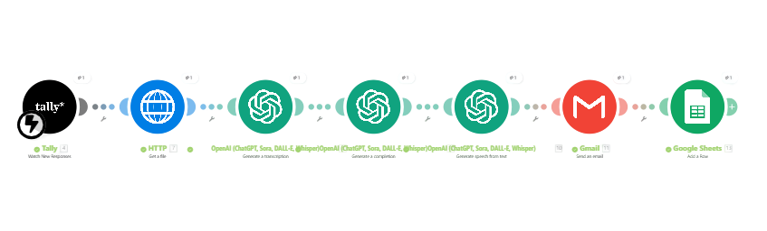
Voice AI Assistant Blueprint
Chatbot & Conversational AI Guide

Slide 2

Overview
A practical step-by-step blueprint to build a no-code Voice AI Assistant using ChatGPT, Whisper, Make.com, Tally, Gmail, and Google Sheets.

Slide 3
Workflow
Tally → Whisper → ChatGPT → TTS → Gmail → Google Sheets

Slide 4
How It Works
1. User submits voice input via Tally
2. HTTP module downloads audio
3. Whisper converts audio to text
4. ChatGPT processes and generates a reply
5. TTS converts the reply to audio
6. Gmail sends an audio reply
7. Google Sheets logs everything

Slide 5
Modules
• Tally – Watch New Responses
• HTTP – Get a File
• OpenAI Whisper – Transcription
• OpenAI Completion – AI Reply
• OpenAI TTS – Voice Output
• Gmail – Send Email
• Google Sheets – Add Row

Slide 6
Step 1: Tally Input Form
• Create a file upload form
• Collect: Name, Email, Voice File
• Allowed formats: mp3, wav, etc
• Publish and connect to Make.com

Slide 7
Step 2: HTTP Get File
• Fetch the audio file
• Map: File URL → HTTP Get a File
• Output: Binary data + Filename

Slide 8
Step 3: Whisper Transcription
• OpenAI → Generate a transcription
• Model: whisper-1
• File Data: binary file
• Output: text transcription

Slide 9
Step 4: ChatGPT Processing
• OpenAI → Generate Completion
• Model: gpt-4o-mini
• System Prompt: friendly assistant
• Input: Whisper transcription

Slide 10
Step 5: Convert to Voice (TTS)
• OpenAI → Text-to-Speech
• Model: gpt-4o-mini-tts
• Voice: Alloy
• Output: MP3 audio reply

Slide 11
Step 6: Email Delivery
• Gmail → Send Email
• To: User's email
• Subject: AI Voice Reply
• Attach MP3 audio

Slide 12
Step 7: Logging in Google Sheets
• Google Sheets → Add Row
• Log: Timestamp, Email, Transcription, AI Reply,
Audio Link

Slide 13
Troubleshooting
• Whisper Error → Use HTTP Get File
• Empty Output → Check audio length
• Base64 → Decode first
• Gmail Fail → Check permissions
• Sheets Fail → Fix column mapping

Slide 14
Best Practices
• Keep voice requests clear
• Test modules individually
• Add filters
• Store audio history

Slide 15
Use Cases
Productivity: summaries, reminders
Business: support automation
Education: explanations
Personal: notes, lists
Content Creation: captions, summaries, outlines

Slide 16
Next Steps
  Download templates
  Build advanced assistants
  Expand to WhatsApp/Telegram

